Slide 1
HGST Software Development Defect Tracking, Migration and Integration Aligning To Common Toolset
Paul Buenrosto
David Hinz
Information Security &Technology

Slide 2
Agenda
Introductions
HGST
Your Firm?
HGST: Current Environment / Desired State
Areas of Discussion / Input Requested:
Cloud vs on-premise for an Enterprise environment
Atlassian OnDemand (SaaS) and AWS
Atlassian tools integration
Enterprise Support
Troubleshooting and ongoing support
Support for PoC
Data Migration from FogBugz to Jira
Proposed Next Steps

Slide 3
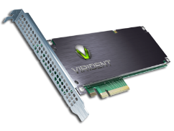

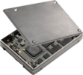
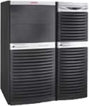
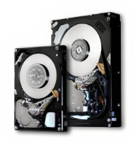



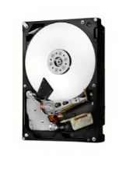
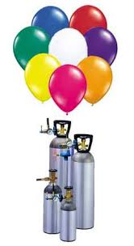
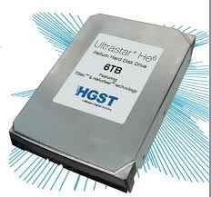

HGST History
Cloud & Datacenter
Founded in 2003 through the combination of the hard drive businesses of IBM, the inventor of the hard drive, and Hitachi, Ltd (“Hitachi”)
Acquired by Western Digital in 2012
More than 4,200 active worldwide patents
Headquartered in San Jose, California
Approximately 42,000 employees worldwide
Develops innovative, advanced hard disk drives, enterprise-class solid state drives, external storage solutions and services
Delivers intelligent storage devices that tightly integrate hardware and software to maximize solution performance
Performance Enterprise
PCIe
Enterprise SSD
(+3 acquisitions in 2013)
SAS
10K & 15K HDDs
Ultrastar®
Capacity Enterprise
7200 RPM & CoolSpin HDDs
Ultrastar® & MegaScale DC™
Ultrastar® Helium Platform Enterprise Hard Drive

Slide 4
Introductions
Please provide a short introduction of your firm here.

Slide 5
HGST: Current Environment / Desired State
Current Environment
Many software development environments due to legacy, shifting of product lines, acquisitions, etc.
Many commercial and home grown tools used in tandem
Ex: FogBugz and home grown tools/methods for tracking software defects
Teams distributed worldwide, many new from acquisitions
Growing list of partners.
Desired State
Alignment to common set of tools for basic capabilities
Correct utilization of on-prem / cloud based solutions as appropriate
A tool set that is easy to add users, manage, maintain and cost efficient
Easy to add features / capabilities
Easy to integrate / co-exist with evolving environment
Office365, Jive, Cloud, Salesforce. Git (possible), etc.
BYOD

Slide 6
Cloud vs on-premise (Atlassian)
Compliance to ????
Security and Controls
No SSO for Jira on premise?
LDAP integration?
How easy?
Limited administrative functions
Integration of only a few plugins
Individual themes not supported
Quality
Scalable, 99.9% reliability
No additional hardware requirements
Maintenance tasks
Quickly available?
Economic considerations?
Support considerations?
Feedback and Input?

Slide 7
Cloud vs on-premise (AWS, on-premise )
AWS
Scalable, 99.95% reliability
No additional hardware requirements
No maintenance tasks
Quickly available
Economic
On Premise
99.99% reliability
Control over all systems/data
Corporate data is stored/handled internally
Initial investment is high
Cost
Feedback and Input?

Slide 8
On-premise and AWS Infrastructure
AWS
EC2 Instance type
I2, R3 or C3
Backup strategy
AMI clone
AWS VPN or DirectConnect
On Premise
Hardware requirements
Hardware clustering
App clustering
DB replication
Feedback and Input?

Slide 9
Atlassian tools integration
Jive integration with Jira, Confluence and Crucible
Box Integration requirements
CRM (Salesforce)
SSO

Slide 10
Atlassian Support
Not Enterprise Focused
Slow
No phone or remote host support
Not 24/7
Escalation process not very reliable
3rd party support available?

Slide 11
Areas of Discussion FogBugz Migration to Jira for PoC
IT customer on Jira PoC
Need to migrate a project to Jira
Requirements?
Cloud or on-premise for a PoC?

Slide 12
Requested Next Steps
Additional feedback on items discussed?
Recommendation on how to proceed?
How could you/your firm support HGST’s PoC?
Could you provide an estimate of resources/schedule/$$’s
What would the deliverables be?

Slide 13
Thank You

